Slide 1
School Based Budget Project
Benson Middle School
Anonymous

Slide 2
Benson Middle School
Grades 5-8
Principal: Ron Anthony
Assistant Principal: Tracy Vannurden
Address: 1600 N Wall Street
Benson, NC 27504
Phone: 919-894-3889
Website: http://bms.johnston.k12.nc.us/
“Excellence Without Excuse”

Slide 3
Mission
Mission Statement:
The mission of Benson Middle School is to empower students to become lifelong learners through collaboration among students, parents, educators, and community partnerships. Using comprehensive research based curriculum that is rigorous, technologically advanced, and globally relevant to today’s changing society, we will saturate our students with a thirst for knowledge.

Slide 4
Vision
To empower students to become productive citizens in a global society.
To ensure success and quality education for all students through collaboration among students, parents, educators, and community.
Benson Middle School strives to provide opportunities for our students through partnerships with the community. Our students participate with interest based clubs designed to keep them engaged. Our students are enrolled in rigorous classes designed to promote their growth academically.

Slide 5
School History
Benson Middle School is located in the town of Benson, North Carolina which is in Johnston County. The town lies at the intersection of Interstates 95 and 40. Benson Middle School has been marked as a low performing school (Tier II School) by the State of North Carolina Department of Public Instruction.

Slide 6
Student Enrollment and Demographics
2015-2016 Total Enrollment-419 Students
White-53.9% (approximately 226 students)
Hispanic-26.3% (approximately 110 students)
African-American-16.2% (approximately 68 students)
Other-3.6% (approximately 15 students)
53% Male and 47% Female
Free and Reduced Lunch
64.2% of student population

Slide 7
Staff Demographics
Classroom Teachers
 | Our School | 32
Fully Licensed Teachers
 | Our School | 88%
Teachers with Advanced Degrees
 | Our School | 6%
National Board Certified Teachers
 | Our School | 1
Years of Teaching Experience.
 |  | 0 - 3 Years | 4 - 10 Years | 10+ Years
 | Our School | 16% | 56% | 28%
Teacher Turnover Rate
 | Our School | 38%

Slide 8
S.I.P. Goals 2016-2017
Collaborate to establish strategies for faculty to become more aware of students’ emotional states by 07/31/2018 as measured by a decrease in out of school suspension, in school suspension, and period detention by 50%.
Demonstrate student proficiency (pass rate) in reading by 06/09/2017 as measured by an increase in the percent of students demonstrating grade level proficiency of level 3 or higher on the NC EOG from 52.2% to 55%.
Demonstrate student proficiency (pass rate) in math by 06/09/2017 as measured by an increase in the percent of students demonstrating grade level proficiency of level 3 or higher on the NC EOG from 39.6% to 43%.
Increase student growth in reading by 06/09/2017 as measured by Fountas and Pinnell reports and student growth.
Collaborate to improve communication and involvement with parents, community, and local businesses by 06/30/2017 as measured by student growth, parent and community surveys and involvement.

Slide 9
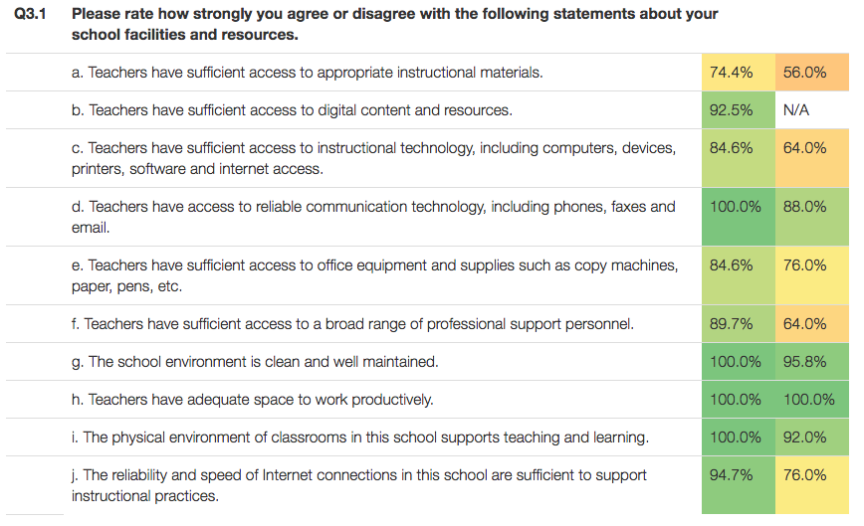
T.W.C. Results 2014 & 2016
2016 2014

Slide 10
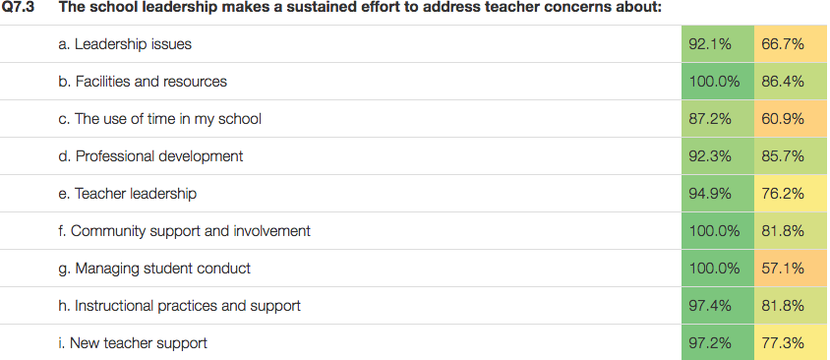
T.W.C. Results 2014 & 2016
2016 2014

Slide 11
Recent Testing Data-Reading

Slide 12
Recent Testing Data-Math

Slide 13
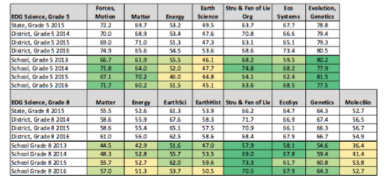
Recent Testing Data-Science

Slide 14
Budgetary Highlights
-069: $16, 283.78 (State) -055: $5,931 (State)
-024: $3,663.70 (State) -061: $22,141.70 (State & Local)
-Title I: $189,630 (Federal) -801: $3,311 (State)
-001: $1,325: (State)
-031: $7,463 (State)
-Total Funds: $249,749.18

Slide 15
Three Largest Expenditures
-Instructional supplies- $20,000
-Fountas and Pinnell monitoring-$10,000
-People (reduction of class sizes, tutors-$83,500

Slide 16
Three Smallest Expenditures
-Problem Based Learning Lessons-$200
-Middle Years Publication-$338
-Phantom Pride Incentive House Competition-$500
-Ruby Payne Poverty Training-$1,000

Slide 17
Concerns
During 2015-2016 school year there were approximately 1,757 referrals written in regards to discipline.
1,000 referrals resulted in ISS
600 referrals resulted in period by period detention
150 referrals resulted in out of school suspensions
7 referrals resulted in long term suspensions
The SIP shows there is heavy focus on Reading, however, there is limited funding put towards Math Intervention. There are no funds that go towards Math monitoring.
Fifth grade in the same building as early adolescents.
Parent and community involvement/engagement

Slide 18
Recommendations
-Implement math intervention and math monitoring
-Implement a Positive Behavior program to provide consistency and decrease office referrals (expectations, consequence matrix, etc)
-Professional development on supporting the needs of students, staff, and community in regards to positive behavior support
-Create/present a plan proposing moving 5th grade
-Host community, collaboration, and consortium nights to increase parent and community involvement and collaboration (academics, career, building partnerships)
-(Cont.) Professional development for math and science teachers

